Slide 1

DriverPass
System Analysis
Enrique Zarate
Notes:
[No speaker notes required for this slide.]

Slide 2

System Requirements
Functional Requirements
  Students can schedule driving lessons through the program.
  Students can track their progression to be driver test ready.
  Driving Instructors can leave feedback for students from their driving lessons.
  Students can access learning materials from their resource pages.
Non-Functional Requirements
  Web-based so it can be accessed during most times.
  Web-based will allow for a variety of browsers and users.
  Users will have unique user Ids
  Username and Login are required to access website.
Notes:
Hi there, here is a list of some of main actions of our program. First off, students need to be able to schedule driving lessons with their mentor through this program. This one is a huge one as it’s one of our biggest focuses in allowing to have students have in person driving lessons. As Liam stated in our initial meetings, that it was important to allow students to make online reservations for the driving lessons. Students need to also be able to track their progress by every now and then testing themselves with our exam preparation module. Liam also stated that they should be able to see their current progress based on how they do on the test. A diagram of what the student profiles looks like that was provided by DriverPass also indicated that the ability for feedback to be left by the driving mentors was also a priority. Students will also have the ability to access student resources that would be available to them depending on the package that was purchased coming in. The idea of packages was brought up in the initial stages of development and for now, we have created the three packages that Liam wanted and we will work on the ability to add customized packages at a later time.
Some of the non-functional requirements or the system requirements are needing to have the system be a web-based program so it is always up and can be accessed from anywhere with an internet connection. Liam stated that he wanted an offline option as well in which we created a way for him to export reports from the program in the case that he is going to not have access to internet. Having the program be web-based will also help with our large range of audience that we will be able to reach. All users need to have their own userId in order to ensure that only specific profiles can be viewed by the owner’s of the profile and admins. Along with this requirement, data for individuals has to be kept safe and so each person will have to create a username and password in order to be able to access the site while keeping the website and individuals data secure. All of these can be reference in the DriverPass Interview Transcript.

Slide 3
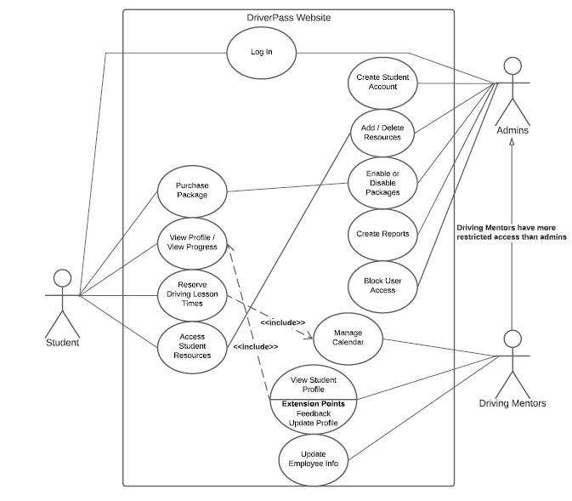
Use Case Diagram
[Insert your use case diagram here.]
Notes:
This diagram here shows how the different users of the program can interact with the website. For example, the three users are gong to be students, a few admins, and employees. The student will have access to their basic functions such as being able to purchase the plan that will best help them pass the driver’s test, view their own profile, and schedule drivers lessons as mentioned earlier. Admin users have some bigger roles and rights that they can access. For example, if they feel they have too many students at one time, the admins can disable the packages so that way no more are sold during their busy time. The driving mentors will have the ability to leave feedback on customer/student profile pages. In some cases, some of these relationships between two cases from different users shows that there is a consequence from one item to another depending on how the user interacts with it. For those that may not understand why there is an arrow pointing from the driving mentors to the admins, it’s because the driving mentors are essentially a subset of admins but they have fewer rights.
Does anyone have any questions on this currently as it is?

Slide 4
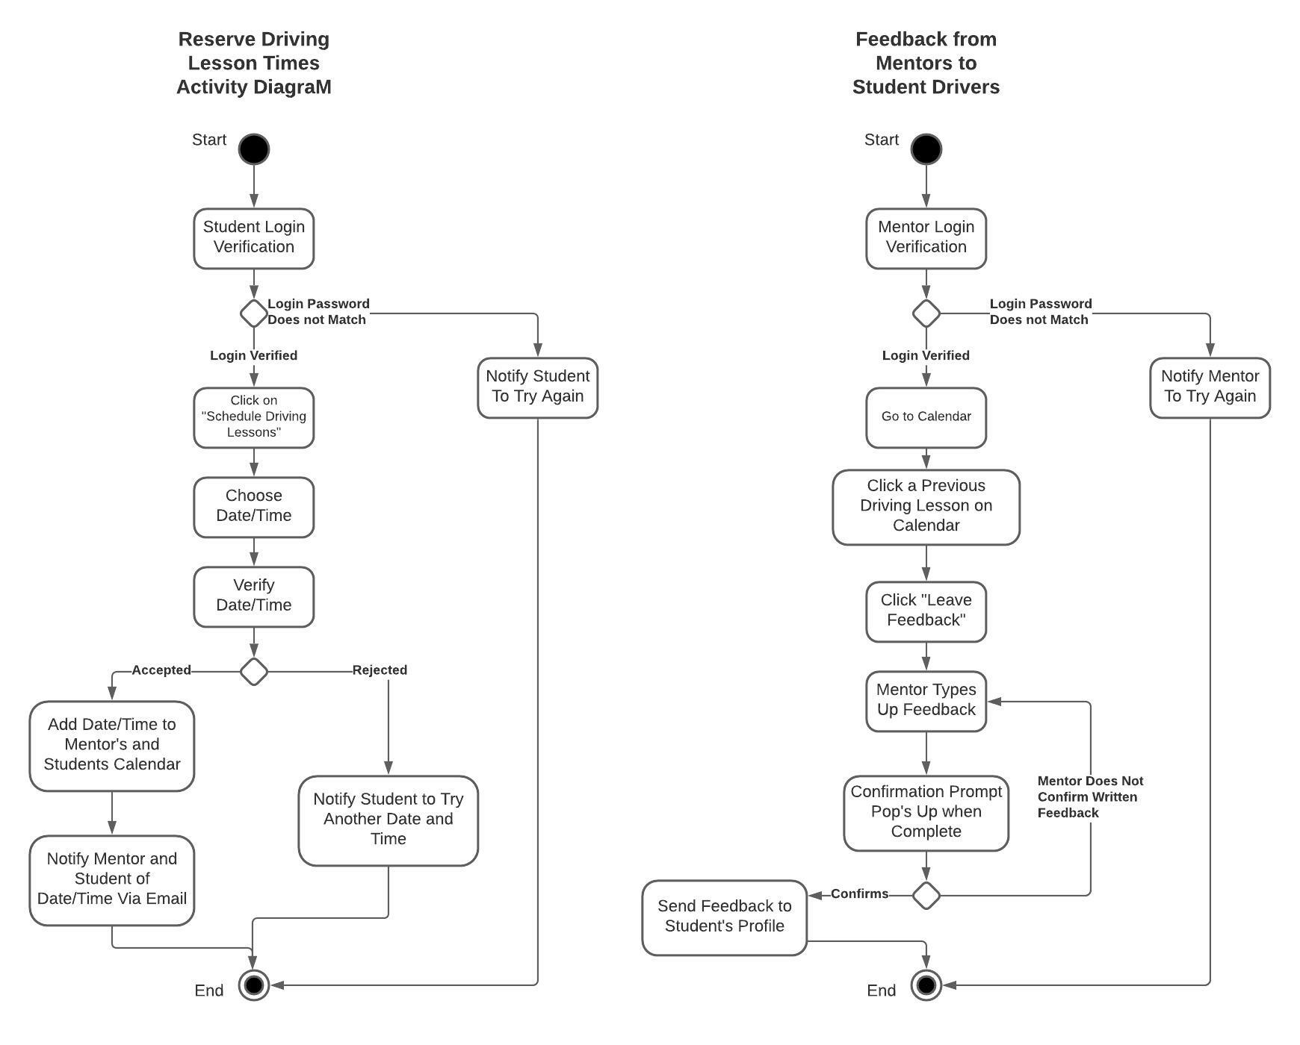
Activity
Diagram
[Insert one of your activity diagrams here.]
Notes:
The use case I have decided to break down was the reservation system that can be initiated by the students. After the student has logged in, they can move over to their reservation page to start the process of scheduling an appointment or reservation for driving lessons. Once here, the students will be asked for a date and time that works best for them. When they have confirmed their date and time of choice, a notification goes out to a few of our driving mentor’s and they will have a chance to either accept or reject it. If it is accepted, the students are notified that it was accepted and the website will update the calendar for both the student and the driving mentor. If it is rejected by all of the driving mentor’s because they are just not available, the student will be asked for a different date.
At any time, if a user is unable to login because of failed attempts, they may need to reset their password with an email to admin staff.
This design is important because it is one of the primary activities that were mentioned multiple times in conversations with Liam.

Slide 5
Security
Usernames and Passwords Required
Temporary Lock after 3 Fails Attempts
Admins have access to block any users at any time
Security through third party web service encryption
Notes:
Security is so important to many of us and we want to make sure that we show DriverPass everything we are doing to protect the data of your customers/employees and partners. Like all security systems, each person has to have their own access to their own profile. This is always done with a username and a password. If hackers are trying to break into our system with automated systems, our system will only allow three attempts before locking that user out. For whatever reason, if any of those first two fail with the security as it is, the admin users have the ability to block out anyone at any time. We have also made sure to keep data safe so what it is traveling over the internet, it is being disguised as something else before leaving peoples devices and going to the central hub.
Does anyone have any questions about security?

Slide 6
System Limitations
Most people have access to internet, it may not always be good.
Password Reset Needs to be granted by Admin
Some Browsers may not support our Development
Notes:
There are some limitations in almost every system and it’s important we go over the one for Driver’s Pass. Since this is a web-based app, our customers need to have access to the internet. In most cases, most people will be able to get it when needed. The kind of internet they have access to can vary in data speeds, how often the connection drops. Simplifying our web pages for fast loading will help with this issue. Most places allow for password resets by the customer but DriverPass wanted to retain the rights for resetting the passwords for customer upon requests. The last limitation is that we know many of the mainstream browsers out there like internet explorer, google chrome, and safari but there are also other kinds of browsers out there that sometimes may be from lower quality devices. We will have to monitor these limitations as we release more and more iterations to figure out where we can re-adjust to either solve these limitations or at least reduce them as much as we can.

